Slide 1
Trabajo Práctico Nº 1: Las palabras clave
INGLÉS PARA INGENIERÍA EN SISTEMAS
INGLÉS II PARA TUARI
2020

Slide 2
Temas
Conceptual:
Palabras clave: concepto, función e importancia.
Escritura:
Introducir el título y autor de un trabajo de acuerdo a normas académicas en lengua materna.

Slide 3
Concepto:
Las palabras clave son aquellos términos que le permiten al lector delimitar el campo semántico y el tema sobre el cual requiere información.
Función: nos permiten identificar con facilidad material afín.
Importancia: las palabras clave deberán producir resultados relevantes en un volumen de información cada vez más creciente, sobre todo en el medio digital.

Slide 4
PARTE A
¿Con cuál de los siguientes temas asociaría las palabras encerradas en el cuadro?

Slide 5
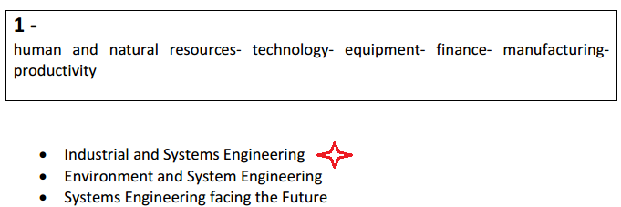

Slide 6
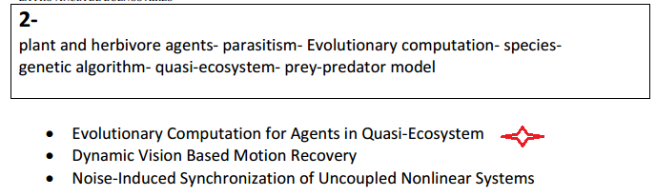

Slide 7
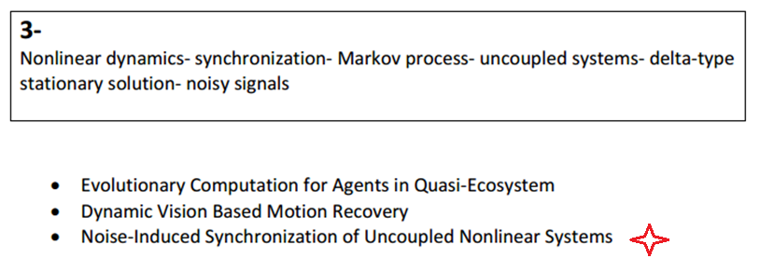

Slide 8
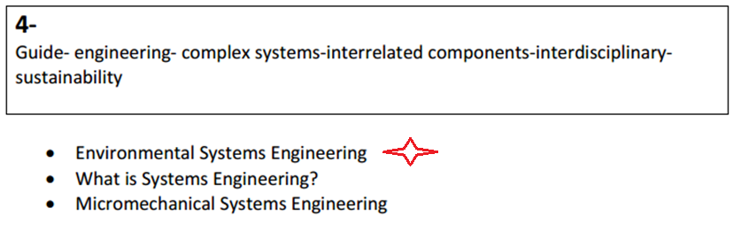

Slide 9
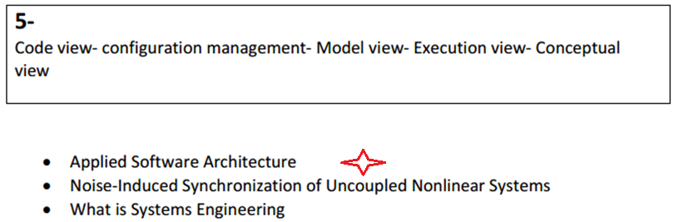

Slide 10
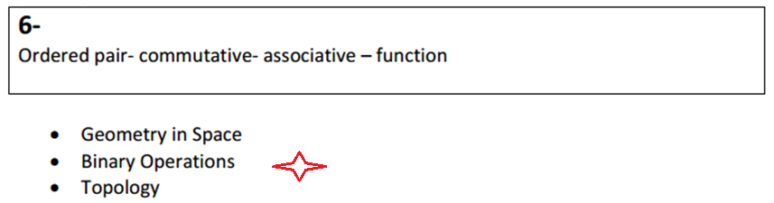

Slide 11
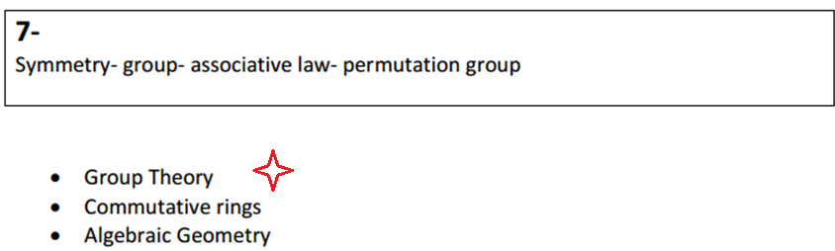

Slide 12
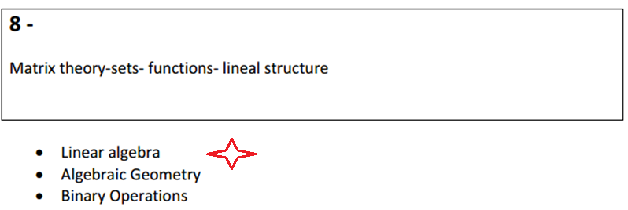

Slide 13
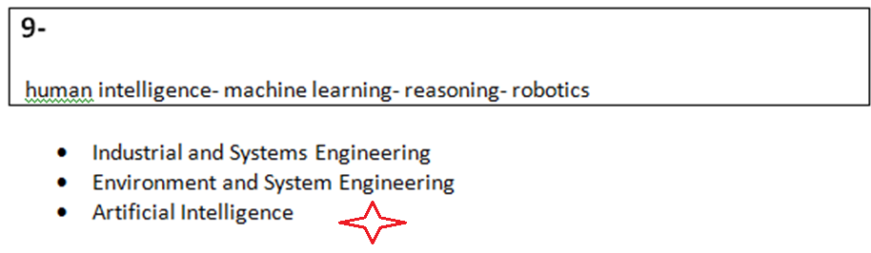

Slide 14
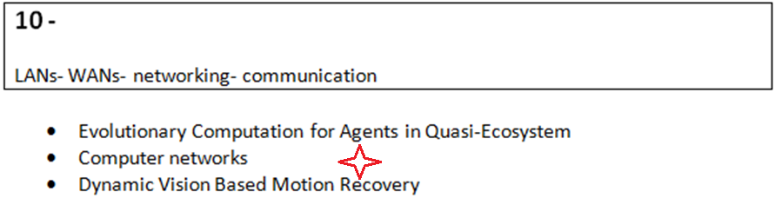

Slide 15
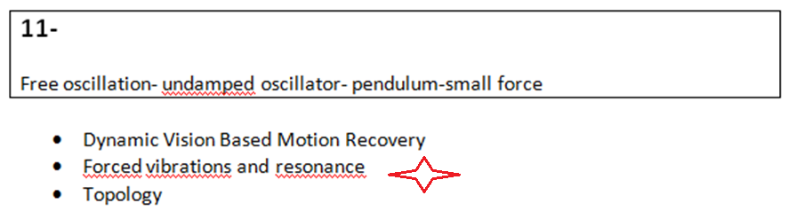

Slide 16
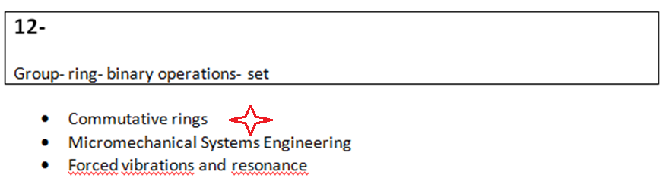

Slide 17
PARTE B
LEA los textos a continuación y ASIGNE un título adecuado teniendo en cuenta las clasificaciones hechas en A.

Slide 18
1- Evolutionary Computation for Agents in Quasi- Ecosystem
This paper deals with a quasi-ecosystem by an evolutionary learning method for agents in the quasi-ecosystem. The quasi-ecosystem is composed of plant and herbivore agents, which are in a relationship of parasitism. The selfish behaviour which satisfies themselves leads to extinction because resources in the environment are finite. Evolutionary computation is adopted to update feed rules of herbivore agents. Extinctions can be avoided by maintaining numerical balance between each species. The effectiveness of the proposal approach is demonstrated by computer simulations.

Slide 19
2- Artificial Intelligence
This is a complex, highly interdisciplinary branch of computer science that attempts to incorporate the principles of human intelligence and reasoning into computing systems. AI research is concerned with modelling all facets of human intelligence, but most often the research involves creating computer systems that have the ability to plan (automated deduction), adapt to different situations (machine learning), acquire human-like senses (machine vision and natural-language processing), and effect changes to the environment (robotics). Introductory courses in AI are offered at the undergraduate level; in- depth study is available at the graduate level.

Slide 20
3- Industrial and systems Engineering
It is one of the fastest growing areas of engineering. It looks at the "big picture" of what makes organizations work best—the right combination of human and natural resources, technology and equipment, and information and finance. Industrial and systems engineering is vital to solving today's critical and complex problems in manufacturing, distribution of goods and services, health care, utilities, transportation, entertainment and the environment. Industrial and systems engineers design and refine processes and systems to improve quality, safety and productivity.

Slide 21
4- Group Theory
Formally, a group is a set G on which there is a multiplication '*' defined, satisfying the associative law. In addition, there is to be an element '1' in G with 1*g=g*1=g for every g in G; and every element g in G must have an inverse h satisfying g*h=h*g=1.
A particularly important class of groups is the set of permutation groups, those in which the elements are permutations of some set, and the group operation is simply composition. For example, the symmetric group on N objects is the set of all N! rearrangements of the N elements. Other important examples include the alternating groups and the Mathieu groups. In some sense, every group is a permutation group, but interesting questions arise in relation to the action on the set. For example, one considers groups which are highly transitive (they include enough symmetries to permute many large subsets) or groups which preserve additional structure of the set being permuted (angles in space, for example). Many combinatorial questions can be reduced to questions about the symmetric group; even the Rubik's cube can be viewed as a puzzle concerning a particular permutation group.

Slide 22
5- FORCED VIBRATIONS AND RESONANCE
Everybody has at least a qualitative familiarity with resonance, and probably the most striking feature of the driven oscillator is the way in which a periodic force of a fixed size produces very different results depending on its frequency. In particular, if the driving frequency is made close to the natural frequency, then (as anyone who has pushed a swing knows) the amplitude of oscillation can be made very large by repeated applications of a quite small force.

Slide 23
6- WHAT IS SYSTEMS ENGINEERING?
Three commonly used definitions are provided by the best known technical standards that apply to this subject. They all have a common theme:
• A logical sequence of activities and decisions that transforms an operational need into a description of system performance parameters and a preferred system configuration. (MIL-STD- 499A, Engineering Management, 1 May 1974. Now cancelled.)
• An interdisciplinary approach that encompasses the entire technical effort, and evolves into and verifies an integrated and life cycle balanced set of system people, products, and process solutions that satisfy customer needs. (EIA Standard IS-632, Systems Engineering, December, 1994.)
• An interdisciplinary, collaborative approach that derives, evolves and verifies a life-cycle balanced system solution which satisfies customer expectations and meets public acceptability. (IEEE P1220, Standard for Application and Management of the Systems Engineering Process, [Final Draft], 26 September 1994.

Slide 24
PARTE C
¿Qué temas se relacionan con las referencias bibliográficas a continuación?
Temas:
Computer science
Water pollution
Estimation of the accuracy
Map production
Mathematical analysis
Soil compressibility and settlement
Shape and size of the Earth

Slide 25
MAP PRODUCTION
a) Campbell, J. (1984). Introductory Cartography. Prentice Hall. New Jersey.
The book is conceived as the text for a general, introductory course in cartography - the type of course that is a vital component of many undergraduate geography programs.

Slide 26
Shape and Size of the Earth
b) Wilford, H.M. (1981). The Mapmakers. Alfred A. Knopf. New York.
A non-technical history of cartography that includes a description of the expeditions to Lapland and Peru to verify the flattening of the earth at the poles.

Slide 27
Computer Science
c) Burris, S. (1998). Logic for Mathematics and Computer Science, Prentice Hall.
This is an elective course for MSc students. Topics covered: Propositional logic, conjunctive and disjunctive normal forms, resolution, Horn clauses. Equational logic, unification, term rewrite systems, the Knuth-Bendix procedure. Predicate clause logic. Logic with quantifiers. Historical overview of the (modern) logics and computing.

Slide 28
Water pollution
d) Chorley, R.J. (1969). Introduction to Geographical Hydrology. Methuen.
This paperback is concerned with the interactions between water occurrence and human activity (world's water inventory, rain-making, use of groundwater, human use of rivers and choice in water use).

Slide 29
Soil compressibility and settlement
e) Whitlow, R. (1983) ed. 1990. Basic Soil Mechanics. Longman Scientific & Technical. Essex.
This book is intended as a main text in the basic theory and principles of soil mechanics in the fields of building and civil engineering. It is assumed that the reader will have a basic grounding of mathematics and science, particularly basic mechanics.

Slide 30
Mathematical Analysis
f) Hutchinson, J. (1994) Equations and Functions. Department of Mathematical Science ANU.
The material covered is basic to most of subsequent mathematics courses (e.g. differential equations, differential geometry, measure theory, numerical analysis, to name a few), as well as to much of theoretical physics, engineering, probability theory and statistics. Various interesting applications are included; in particular to fractals and to differential and integral equations.

Slide 31
Estimation of the accuracy
g) Hirvonen, R.A. (1979). Adjustment by Least Squares in Geodesy and Photogrammetry. Frederick Ungar Publishing Co. New York.
The original Finnish edition has been translated by the author and revised by him for English-reading students to demonstrate practical applications of the principle of least squares.

Slide 32
a. relea los títulos y explicaciones propuestas. complete las líneas sugeridas.
En su libro Introduction to Cartography, Campbell (1984) tratará...

Slide 33
En The Mapmakers, Wilford (1981) describe…

Slide 34
En su obra, Burris (1998) desarrolla...

Slide 35
b. elija uno de los apartados del ejercicio anterior y explique de qué trata.

Slide 36
Importante
A menudo el significado de una palabra desconocida está expresado de manera explícita. En un texto, el autor puede definir, explicar, aclarar o acotar un concepto apelando a distintos recursos.

Slide 37
(…..) (Parentheses)
To add information or to explain sth.
Optics (the scientific study of light and the way we see) can be studied in La Plata and in Buenos Aires.

Slide 38
—…— (DASHES)
To add information or to explain something.
Optics—the scientific study of light and the way we see—can be studied in La Plata and in Buenos Aires.

Slide 39
Which (relative pronoun)
Optics, which is the scientific study of light and the way we see, can be studied in La Plata and in Buenos Aires.

Slide 40
That is
Optics, that is, the scientific study of light and the way we see, can be studied in La Plata and in Buenos Aires.
i. e. (written before a word or phrase that gives the exact meaning of something)
Optics, i. e. the scientific study of light and the way we see, can be studied in La Plata and in Buenos Aires.

Slide 41
Examples to analyse
Measured data can be stored on a hard disk or floppies in the surface unit for subsequent processing and plotting or printing.
This probe is used to determine the magnetizability (magnetic susceptability) of rocks.
The physico-mechanical properties of rocks in individual areas are studied using a system of intersection paths–rays.
Many interpretation techniques have been suggested for seismic refraction surveying. But many of them (many interpretation techniques), including interpretation software presently available on the market, expect too much from nature.

Slide 42
EXAMPLES TO ANALISE
Logstation, which is an Intergraph’s workstation-based log analysis software, takes full advantage of sophisticated graphics and programming technology.
The concept has been criticized as tautological, that is, circular in its reasoning.
Agile–denoting the quality of being agile, ready for motion, nimbleness...

